Slide 1
Structured Query Language (SQL) Overview
The Nature of Data and Relational Database Design

Slide 2
Structured Query Language (SQL)
Programming language for managing data in a RDBMS
CREATE a DATABASE
CREATE TABLE in a database
Query (SELECT) data from table(s)
INSERT records to a table
UPDATE or modify records in a table
DELETE records from a table
Notes:
Structured Query Language (SQL) is the language used for managing data in a RDBMS. This database programming language allows for interacting with a database to perform operations such as select, insert, update, delete, as well as many others. Some RDBMS implementations vary in support of SQL, and features can differ among various vendors. In this demo, we will explore several basic concepts, such as:
Create a database
Create tables in a database
Query a database table
Insert records to a database table
Update or modify records in a table
Delete records from a table
There are many more features and functions that are supported, and many professionals have spent a career mastering the concepts and deep learning required here. Obviously, many of the advanced concepts of SQL are beyond the scope of this course.

Slide 3
Data Definition Language (DDL)
Structures of a database
Schema
Database
Tables
Constraints
Examples include:
CREATE
ALTER
Notes:
Data Definition Language (DDL) defines the structures of a database:
Schema
Database
Tables
Constraints
Examples would be CREATE or ALTER statements. We will see examples in just a minute.

Slide 4
Data Manipulation Language (DML)
Used to manipulate data
Examples include:
SELECT
INSERT
UPDATE
DELETE
Notes:
Data Manipulation Language (DML) is used to manipulate data:
SELECT
INSERT
UPDATE
DELETE
Again, we’ll see examples in MySQL as we create the database and tables from our design section.

Slide 5
DCL & TCL
Data Control Language (DCL)
GRANT
REVOKE
Transaction Control Language (TCL)
COMMIT
ROLLBACK
SAVEPOINT
SET TRANSACTION
Notes:
Data Control Language (DCL) includes commands like GRANT and REVOKE and focuses on rights, permissions, and other controls of the database system.
Transaction Control Language (TCL) deals with transactions within a database:
COMMIT
ROLLBACK
SAVEPOINT
SET TRANSACTION

Slide 6
Joins and Subqueries
Joins are used to return rows
Gather data from normalized tables
Subqueries return either a single value or a row set
Perform an action and use the result in a query
Notes:
Joins and subqueries are mechanisms for combining data from different tables into a single result set.
Subqueries can be used to return either a single value or a row set. A common use for a subquery may be to calculate the total of all products within our order or an average price of our products.
Joins are used to return rows. A join will allow us to gather data from normalized database tables and return lots of information in a single row.
In this demo, I will be using MySQL Workbench on a Windows PC. I have a local instance of MySQL server running and have connected to that server from within MySQL Workbench.

Slide 7
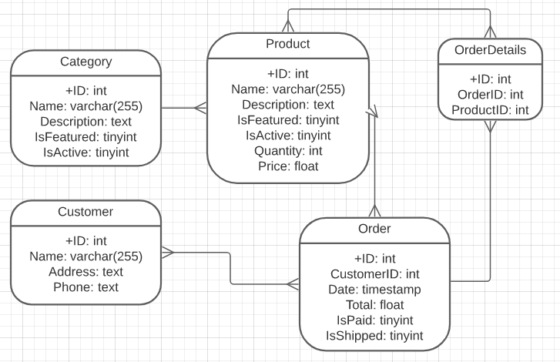
MySQL Workbench Demo
Figure 3: Entity business objects (physical data model) [Long Description]
Notes:
Based on our simple design from the previous module <<show image>>, we will create a database called myStore, which will have 5 tables (Customer, Category, Product, Orders, and OrderDetails. We will now use SQL programming to create the database, the table structures, populate the tables, and execute queries against our new database.
<<Walk through script>>

